Slide 1

Revolution of Technology for Translation and Localisation in the AI Era
Sai-cheong SIU
Associate Professor
Programme Director, Master of Arts in Translation (Computer (-Aided) Translation)
The Hang Seng University of Hong Kong

Slide 2
Acknowledgements
Funding Support: The work described in this talk is partially supported by the following:
a grant from the Innovation and Technology Commission (Project No. ITF/238/17);
a grant from the Research Grants Council of the Hong Kong Special Administrative Region, China (Project No. UGC/FDS14/H16/18);
a grant from the Research Grants Council of the Hong Kong Special Administrative Region, China (Project No. UGC/IDS(R)14/23).

Slide 3







Artificial intelligence (AI) is everywhere!
Chatbots: Facilitating human-like digital conversations
Generative AI: Creating new content, including images and music
Game-playing AI: Mastering and competing in complex games
Image Recognition: Classifying and categorizing images
Object Detection: Recognizing specific items within images
Trend Analysis and Prediction: Predicting future trends, such as stock prices and weather patterns
Robotic Control: Directing robotic operations with AI

Slide 4

AI can also enhance translation technology and professional translation.

Slide 5
Outline
AI for Translation: An Overview
AI in Specialized Translation: Case Studies
Translation of Financial Documents
Platforms 1-4
Translation of Government Documents
Platforms 5-8

Slide 6
AI-driven innovations in financial translation: Examples
Platform 1: Term extractor
Platform 2: Text explainer
Platform 4: IPOTranslate
Platform 3: Sentence finder

Slide 7
AI-driven innovations in translation of government documents: Examples
Platform 5: GovPR Translation
Platform 6: Useful Expression Finder
Platform 8: MTCheck
Platform 7: BlendMT

Slide 8
AI for Translation: An Overview

Slide 9

Artificial Intelligence
Machine Learning
Symbolic AI
Deep Learning
Other Methods

Slide 10




Features of deep learning
1. Multilayered artificial neurons
2. Feature extraction and representation
3. Versatility across domains
4. Resurgence in popularity

Slide 11




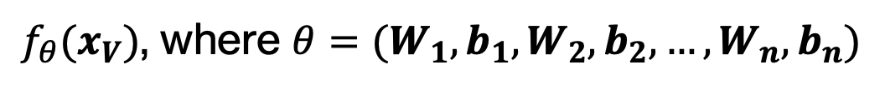
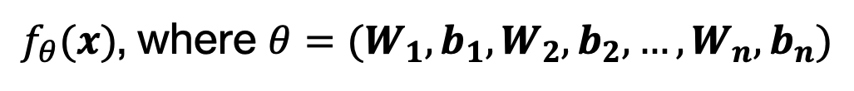
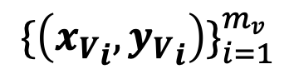
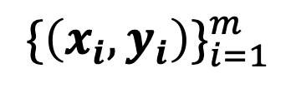
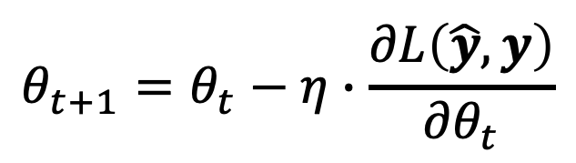
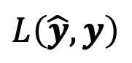
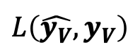

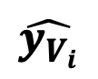
Formally, we have the following:
$${\{\left(x_{i},y_{i}\right)\}}_{i=1}^{m}$$
$$\hat{y_{i}}$$
$$L\left(\hat{y},y\right)$$
$f_{θ}(x)$, where $θ=(W_{1},b_{1},W_{2},b_{2},…,W_{n},b_{n})$
Training
$$θ_{t+1}=θ_{t}−η∙\frac{∂L\left(\hat{y},y\right)}{{∂θ}_{t}}$$
$${\{\left({x_{V}}_{i},{y_{V}}_{i}\right)\}}_{i=1}^{m_{v}}$$
$f_{θ}(x_{V})$, where $θ=(W_{1},b_{1},W_{2},b_{2},…,W_{n},b_{n})$
$$\hat{y_{V_{i}}}$$
$$L\left(\hat{y_{V}},y_{V}\right)$$
Validation

Slide 12
AI-driven tools applicable to translation: Examples
Neural machine translation
Large language models (e.g., ChatGPT)

Slide 13



Conventional methods
I go to school by train.
I go to school by taxi. 我坐計程車去學校。
我坐火車去學校。
Translation Model
P(“I”|“我”) x P(“go”|“去”) x ...
Language Model
P(“我坐火車去學校”)
I go to school by train.
我／去／學校／坐／火車／。
我坐火車去學校。
Rule-based Machine Translation
Example-based Machine Translation
Statistical Machine Translation

Slide 14

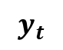
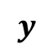


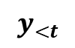
Neural Machine Translation
$$x$$
$$θ$$
ST
Encoder
Internal representation (ST)
$$y_{<t}$$
$$φ$$
$$y_{t}$$
TT so far
Decoder
Internal representation (TT)
Next TT token
$$y$$
TT

Slide 15

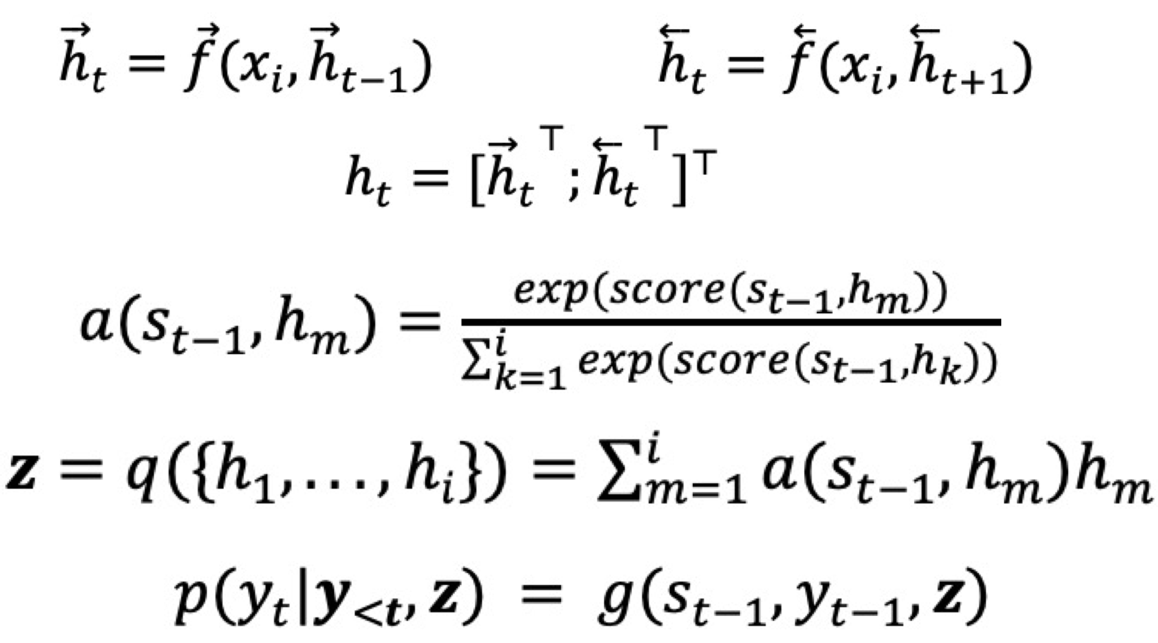
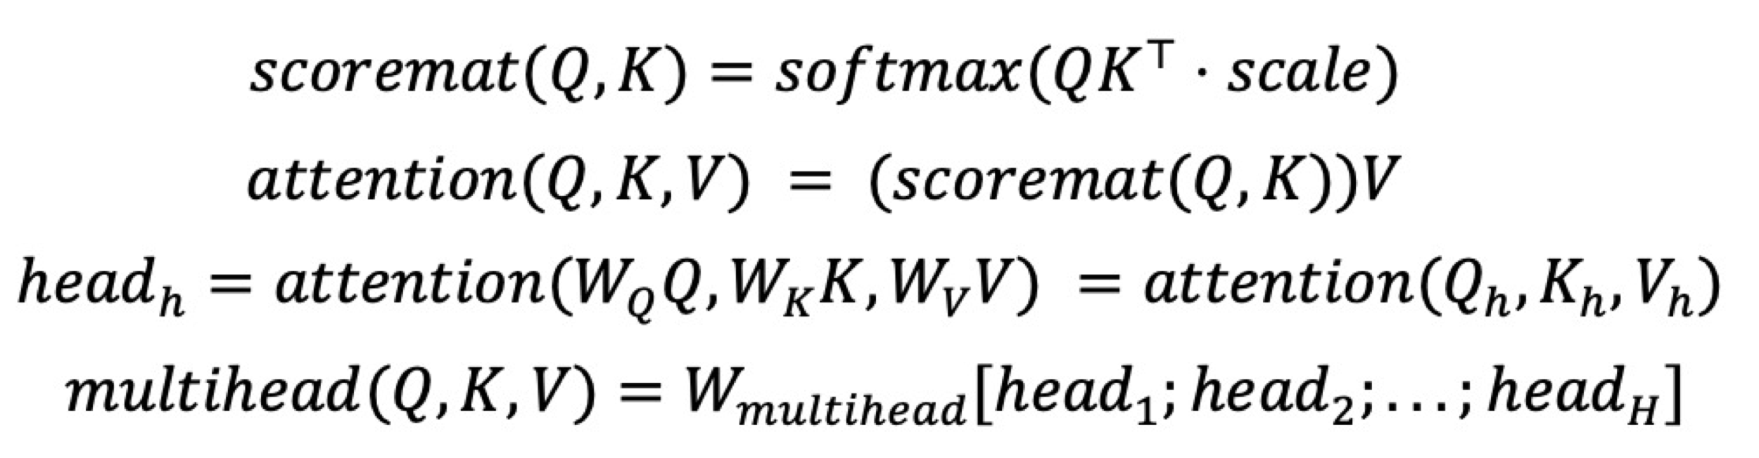
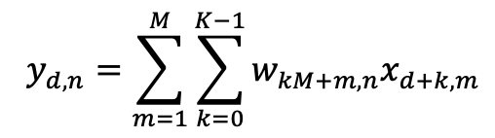
Common types of networks
ChatGPT
1. Recurrent Neural Networks (RNN)
2. Convolutional Neural Networks (CNN)
3. Self-attention Neural Networks (e.g., Transformer)
Bidirectional RNN with Attention
One-dimensional convolutional layer
Multi-head Attention with Queries, Keys and Values
Example:
Example:
Example:

Slide 16

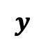
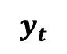

Decoder-based LLMs like ChatGPT
$$m,{x,y}_{<t}$$
$$φ$$
$$y_{t}$$
Prompt + Input
Decoder
Internal representation (TT)
Next token
$$y$$
Output

Slide 17
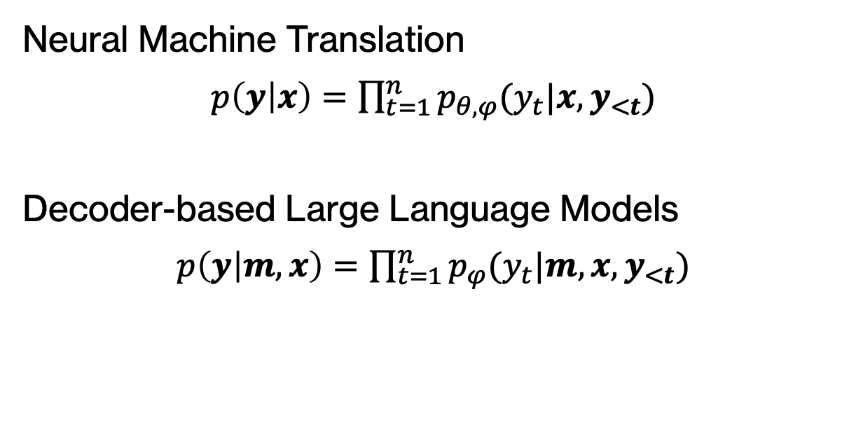
Formally, we have
Neural Machine Translation
$p\left(y | x\right)=$ $\prod_{t=1}^{n}{p_{θ,φ}(y_{t}|x,y_{<t})}$
Decoder-based Large Language Models
$p\left(y | m,x\right)=$ $\prod_{t=1}^{n}{p_{φ}(y_{t}|m,{x,y}_{<t})}$

Slide 18
AI in Specialized Translation

Slide 19
Case Study 1: Translation of Financial Documents

Slide 20






Role of financial translation in HK’s economy
Financial translation is integral to multiple sectors in HK’s vibrant economy.
Banking
Investment management
Insurance
Real estate
Accounting and auditing
Legal services

Slide 21





Significance of financial translation in HK
Enhanced Communication
Transparency
Legal Compliance
Global Market Reach
Facilitates cross-language interactions among investors, clients, and stakeholders
Ensures accurate understanding of financial reports and contracts, fostering informed investment and trust in international transactions
Aids in maintaining compliance with local and international financial laws, reducing legal risk
Enables effective engagement with international clients, increasing potential for foreign investment

Slide 22






Key financial documents
1. Regulatory Documents
2. Company Annual Reports
3. Corporate Announcements and Circulars
4. Market Insights & Financial News
5. Financial Product Marketing Materials
6. Legal and Contractual Documents
Mandatory filings for regulatory bodies (e.g., IPO prospectuses)
Detailed annual overviews of company’s performance and activities
Important updates and news for stakeholders (e.g., major corporate decisions)
Investment analyses and financial news articles
Promotional content for financial products (e.g., product brochures, newsletters, websites)
Legal agreements, contracts, terms and conditions, and disclaimers in financial operations

Slide 23






Challenges of financial translation
Terminology
Ensuring accurate translation of industry jargon
Domain Knowledge
Mastering diverse financial domains
Compliance & Accuracy
Familiarizing with regulations to ensure precision
Confidentiality
Protecting sensitive information
Time Constraints
Managing speed and accuracy
Dynamic Source Text
Translating updated or non-finalized text while maintaining format

Slide 24
Current tools for financial translators
Specialized dictionaries
Electronic databases
Machine translation
Document comparison tools
Translation memories
Terminology databases
Quality assurance tools

Slide 25

Platform 1: Term Extractor
Objective: Our primary goal is to accurately and efficiently extract relevant terms from bilingual documents, thereby achieving AI-assisted term extraction and termbase building.
Translation Enhancement: Our system aims to enhance overall translation quality by improving the consistency, accuracy, and efficiency of term translation.

Slide 26






Conventional methods
Linguistic methods
Term Length: Define minimum and maximum length of terms, typically in number of words (e.g., 1-4 words)
Frequency and Statistical Thresholds: Set a minimum occurrence count for a term to be considered relevant (e.g., at least 5 times) and establish thresholds for statistical measures like TF-IDF (e.g., TF-IDF score above a specific threshold)
Part-of-Speech Patterns: Specify patterns for linguistic methods (e.g., looking for noun phrases or verb phrases)
Dictionary or Stopword List: Provide a list of known terms to seek or common words to ignore
Grammar and syntax rules; POS tagging
Statistical methods
Term frequency and document frequency

Slide 27
Current challenges (1)
Term Length
Some relevant terms or phrases may exceed the user-specified length.
Frequency-Based Limitations
Less frequent but highly relevant terms may be overlooked, while common but irrelevant words may be incorrectly identified.
Overlapping Terms
Extraction may result in overlapping terms, requiring manual filtering (e.g., "heart", "heart disease", and "coronary heart disease").

Slide 28
Current challenges (2)
Linguistic Rules Complexity
Constructing comprehensive and accurate linguistic rules can be challenging due to the complexity of natural language.
Statistical Method Limitations
These methods may struggle with words that have multiple meanings, rare words, and may also require substantial computational resources.
Bi-Text Size
If the text is too short, the accuracy of term extraction may be compromised.

Slide 29
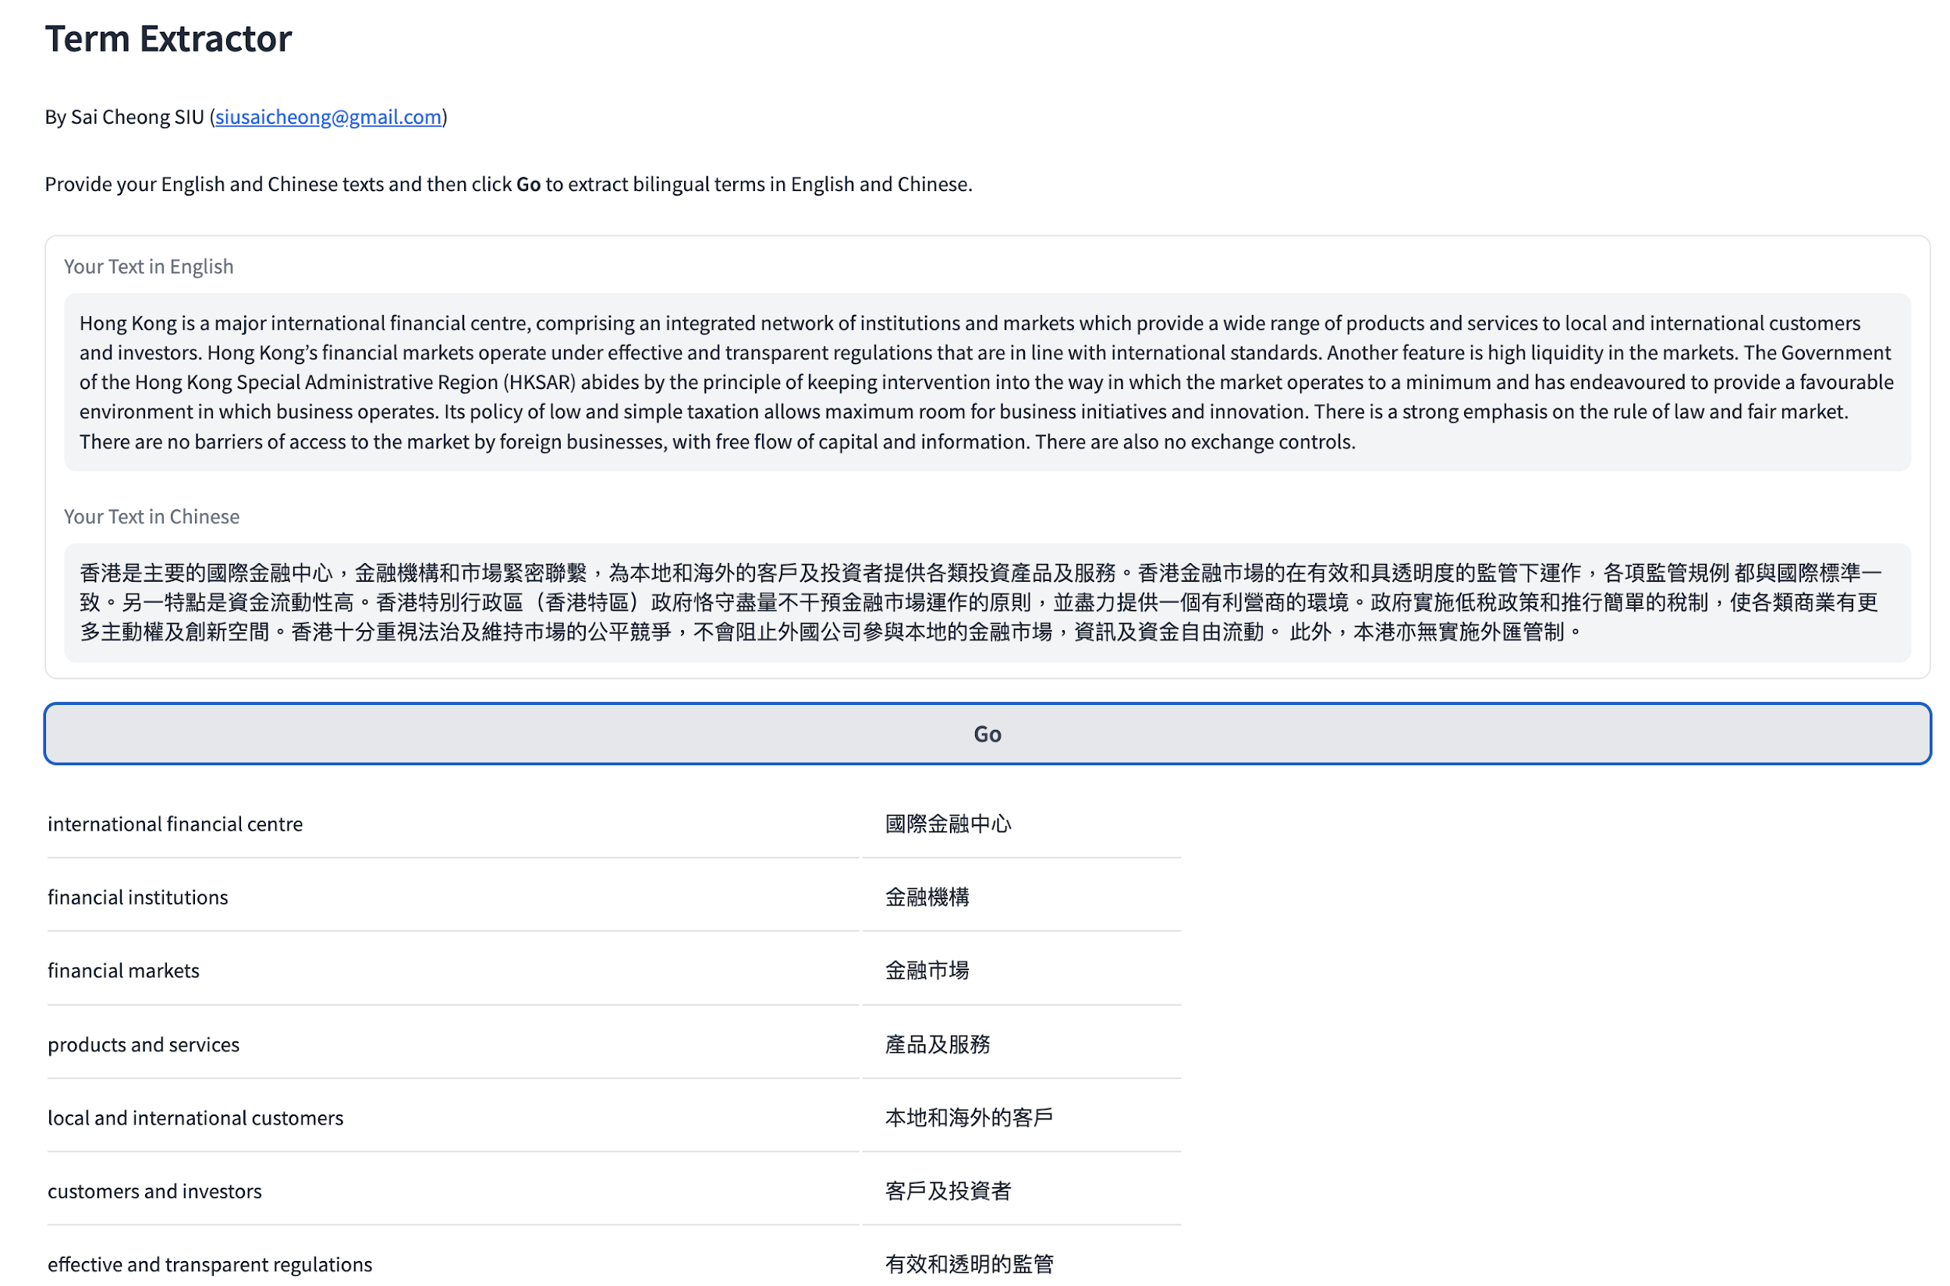

Slide 30
Example
Hong Kong is a major international financial centre, comprising an integrated network of institutions and markets which provide a wide range of products and services to local and international customers and investors. Hong Kong’s financial markets operate under effective and transparent regulations that are in line with international standards. Another feature is high liquidity in the markets. The Government of the Hong Kong Special Administrative Region (HKSAR) abides by the principle of keeping intervention into the way in which the market operates to a minimum and has endeavoured to provide a favourable environment in which business operates. Its policy of low and simple taxation allows maximum room for business initiatives and innovation. There is a strong emphasis on the rule of law and fair market. There are no barriers of access to the market by foreign businesses, with free flow of capital and information. There are also no exchange controls.
香港是主要的國際金融中心，金融機構和市場緊密聯繫，為本地和海外的客戶及投資者提供各類投資產品及服務。香港金融市場的在有效和具透明度的監管下運作，各項監管規例 都與國際標準一致。另一特點是資金流動性高。香港特別行政區（香港特區）政府恪守盡量不干預金融市場運作的原則，並盡力提供一個有利營商的環境。政府實施低稅政策和推行簡單的稅制，使各類商業有更多主動權及創新空間。香港十分重視法治及維持巿場的公平競爭，不會阻止外國公司參與本地的金融市場，資訊及資金自由流動。 此外，本港亦無實施外匯管制。

Slide 31
An online tool
English | Chinese
Hong Kong | 香港
high liquidity | 資金流動性
business | 營商
foreign businesses | 外國公司參與本地
free flow | 自由流動
products | 產品
financial markets | 金融市
markets | 市場
the principle | 原則
Hong Kong’s | 香港金融市場
simple taxation | 簡單的稅制
business initiatives | 商業
institutions | 機構
Configurations: Min. frequency: 1; length range: 1-8

Slide 32
Our tool
international financial centre | 國際金融中心
financial institutions | 金融機構
financial markets | 金融市場
products and services | 產品及服務
local and international customers | 本地和海外的客戶
customers and investors | 客戶及投資者
effective and transparent regulations | 有效和透明的監管
international standards | 國際標準
high liquidity | 資金流動性高
Government of the Hong Kong Special Administrative Region | 香港特別行政區政府
principle of keeping intervention into the way in which the market operates to a minimum | 盡量不干預金融市場運作的原則
policy of low and simple taxation | 低稅政策
maximum room for business initiatives and innovation | 更多主動權及創新空間
rule of law | 法治
fair market | 公平競爭
free flow of capital and information | 資訊及資金自由流動
exchange controls | 外匯管制
17 terms were extracted.
No extra configuration is required from the user's side.
More accurate and useful expressions of varying lengths were extracted

Slide 33
Platform 2: Text Explainer
This tool helps explain financial text, both in terms of terminology and the overall meaning or ideas within the text.
It complements dictionaries and glossaries.
It is particularly useful when dealing with complex financial documents.

Slide 34


Current challenges
Focus on Words and Short Phrases
They provide limited help to users struggling with understanding larger units, long phrases, and multiple expressions.
Lack of Context-Awareness
First point of reference:
Dictionaries and glossaries
For words with multiple meanings, they only provide a list of definitions. Users must manually select the appropriate meaning by going through a long list and considering the context.

Slide 35


Solution offered by our tool
Contextual Explanation: Our tool provides explanations of expressions with reference to their context, automatically providing the definition most relevant to the context.
Support for Larger Units: Our tool offers support beyond individual words, including explanations of longer phrases and even sentences.

Slide 36
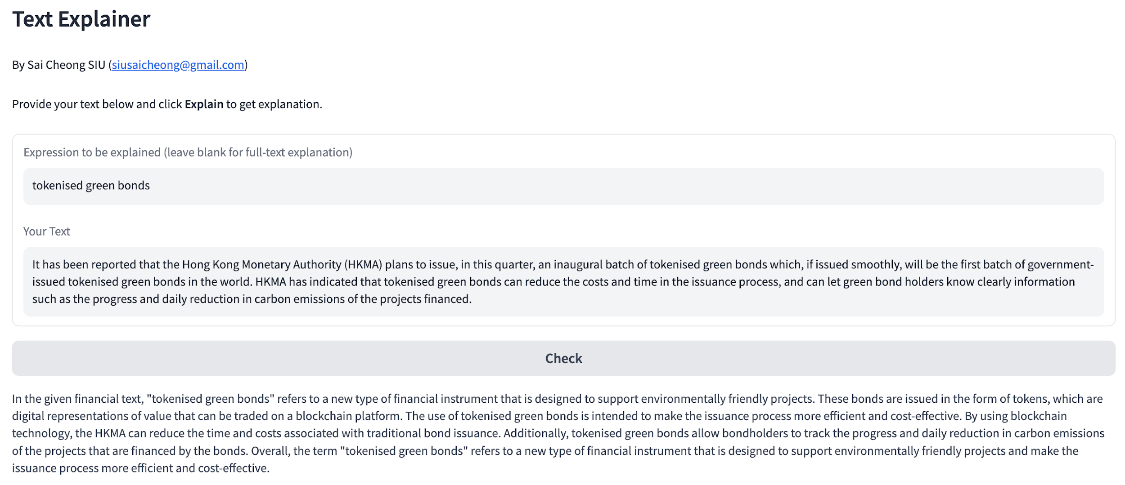
It’s a smart dictionary, featuring (1) context awareness and (2) support for longer expressions

Slide 37
Examples
Example 1: Explaining a common word within a given sentence
Example 2: Explaining a multi-word expression containing a technical term, using a given sentence for context
Example 3: Explaining a given sentence within the context of a paragraph

Slide 38
Example 1
Task: Explain a common word within a given sentence.
Our word here: “sound”

Slide 39
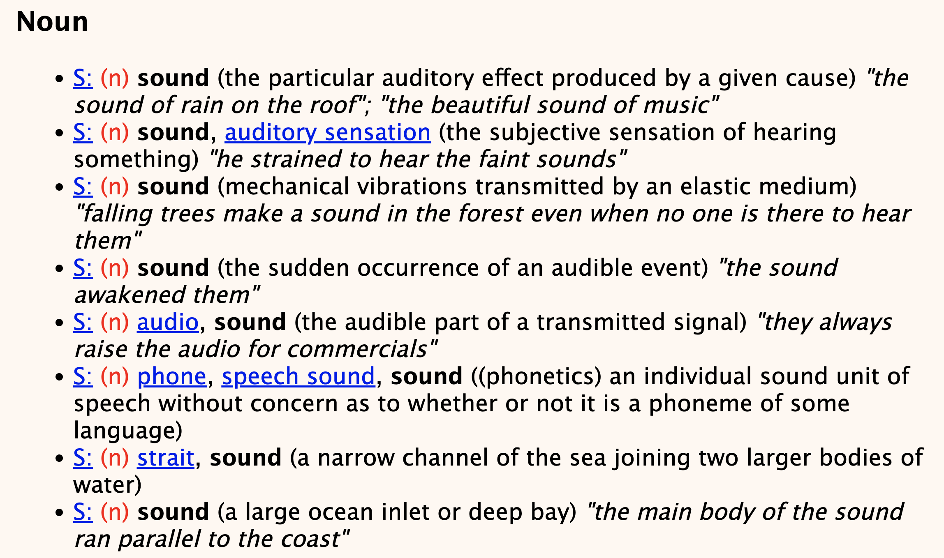
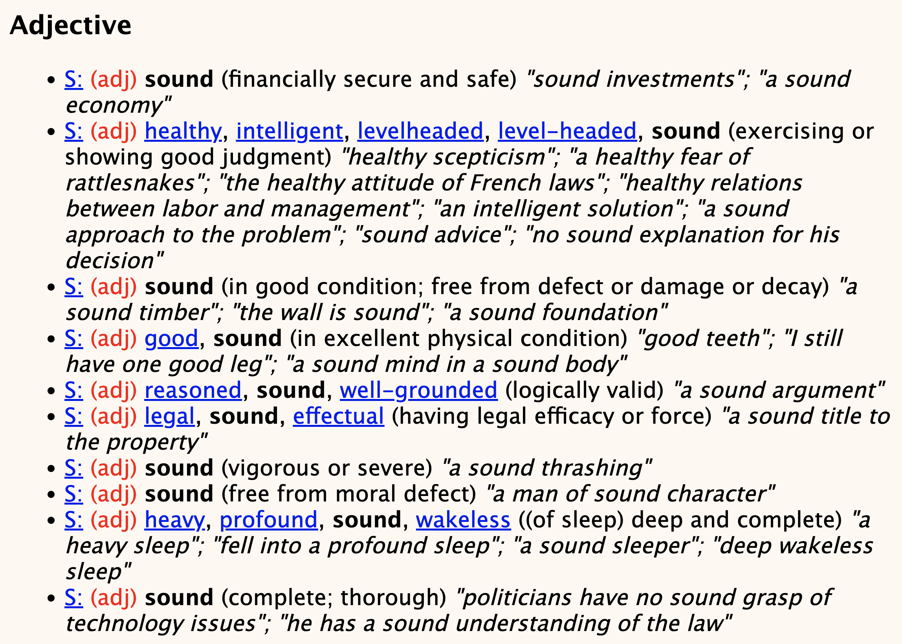
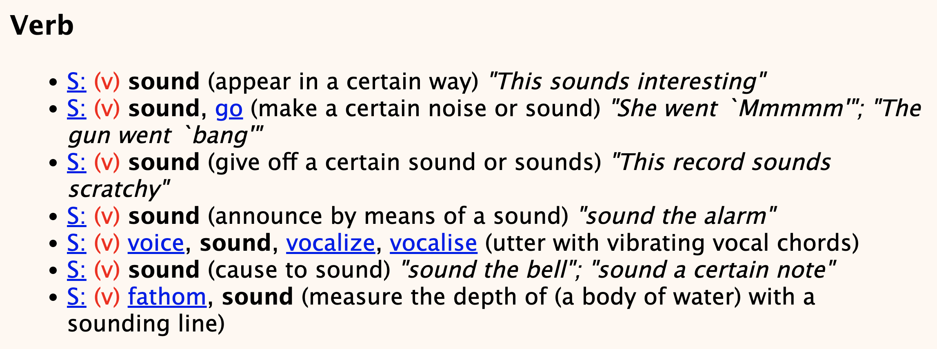
Consider this …
Which one?
Source: WordNet

Slide 40
Now, we have an alternative …

Slide 41
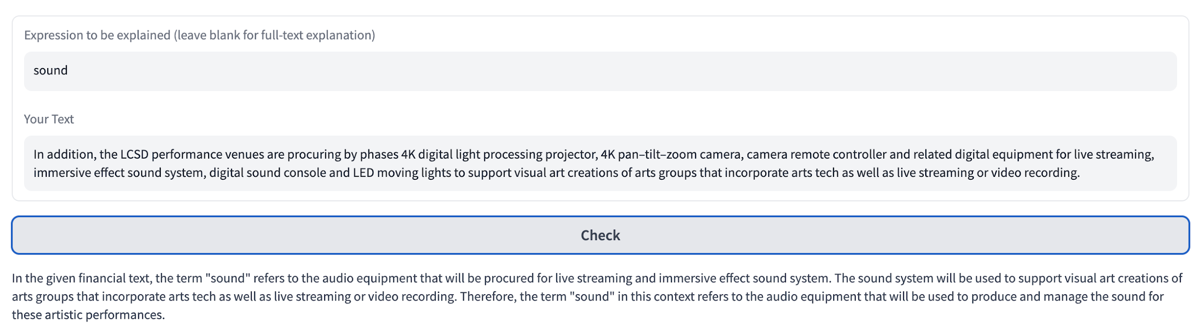
Sound (1)
Context: In addition, the LCSD performance venues are procuring by phases 4K digital light processing projector, 4K pan–tilt–zoom camera, camera remote controller and related digital equipment for live streaming, immersive effect sound system, digital sound console and LED moving lights to support visual art creations of arts groups that incorporate arts tech as well as live streaming or video recording.
Explanation: In the given financial text, the term "sound" refers to the audio equipment that will be procured for live streaming and immersive effect sound system. The sound system will be used to support visual art creations of arts groups that incorporate arts tech as well as live streaming or video recording. Therefore, the term "sound" in this context refers to the audio equipment that will be used to produce and manage the sound for these artistic performances.

Slide 42
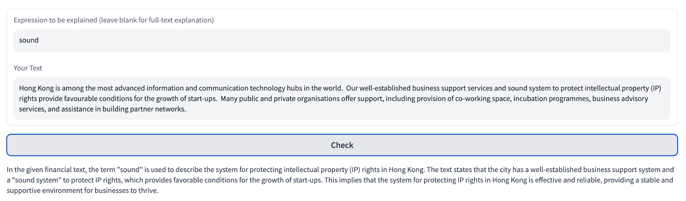
Sound (2)
Context: Hong Kong is among the most advanced information and communication technology hubs in the world. Our well-established business support services and sound system to protect intellectual property (IP) rights provide favourable conditions for the growth of start-ups. Many public and private organisations offer support, including provision of co-working space, incubation programmes, business advisory services, and assistance in building partner networks.
Explanation: In the given financial text, the term "sound" is used to describe the system for protecting intellectual property (IP) rights in Hong Kong. The text states that the city has a well-established business support system and a "sound system" to protect IP rights, which provides favorable conditions for the growth of start-ups. This implies that the system for protecting IP rights in Hong Kong is effective and reliable, providing a stable and supportive environment for businesses to thrive.

Slide 43
Example 2
Task: Explain a multi-word expression containing technical terms, using a given sentence for context.

Slide 44
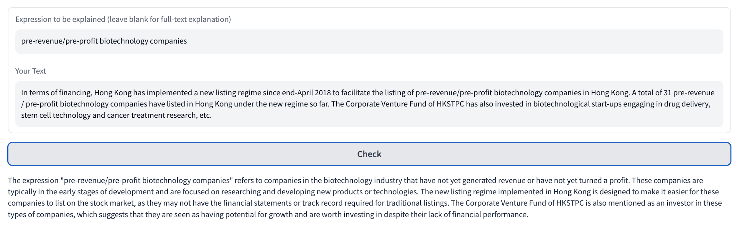
Input: In terms of financing, Hong Kong has implemented a new listing regime since end-April 2018 to facilitate the listing of pre-revenue/pre-profit biotechnology companies in Hong Kong. A total of 31 pre-revenue / pre-profit biotechnology companies have listed in Hong Kong under the new regime so far. The Corporate Venture Fund of HKSTPC has also invested in biotechnological start-ups engaging in drug delivery, stem cell technology and cancer treatment research, etc.
Explanation: The expression "pre-revenue/pre-profit biotechnology companies" refers to companies in the biotechnology industry that have not yet generated revenue or have not yet turned a profit. These companies are typically in the early stages of development and are focused on researching and developing new products or technologies. The new listing regime implemented in Hong Kong is designed to make it easier for these companies to list on the stock market, as they may not have the financial statements or track record required for traditional listings …

Slide 45
Example 3
Task: Explain a given sentence within the context of a paragraph.
Input:
"Hong Kong is a leading player in green finance. In 2022, green and sustainable debts arranged or issued in Hong Kong amounted to over US$80.5 billion," Mr Hui said, adding that the US$101 million tokenised green bond issued by the Hong Kong Special Administrative Region Government in February this year, the first of its kind released in the world by a government, could further entrench the awareness of sustainability issues in combination with technology.

Slide 46
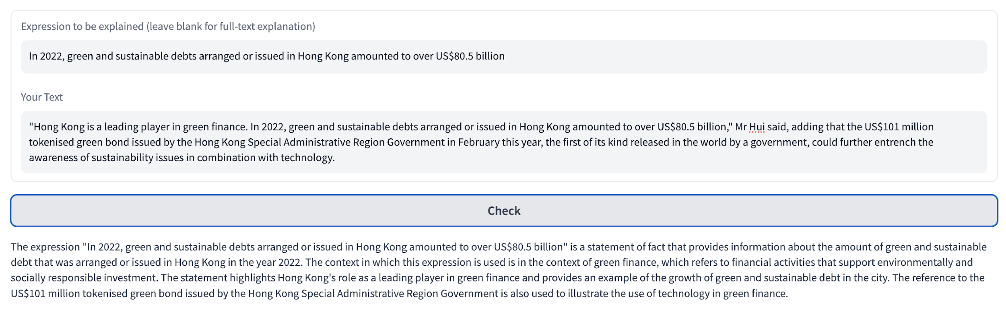
The context in which the given sentence is used.
Explanation of "green finance."
Connection of the given sentence with other parts of the text.

Slide 47
Platform 4: Sentence Finder
This tool assists translators in identifying previously translated or similar sentences or expressions for reference and reuse. This may help reduce the need for retranslating every aspect of the content.
It could also facilitate the alignment of terminology and translation style with those found in previously translated content.

Slide 48


Conventional form of TM
1. string similarity
New SL
sentence
Existing SL
sentence
Corresponding TL
sentence
2. Aligned bilingual sentences

Slide 49
Current Problems with TMs
Semantic vs. Syntactic Similarity
Conventional methods often depend on string similarity in terms of edit distance. However, syntactically similar sentences may not be semantically relevant.
Example: "The company's stock price rose" and "The company's stock price fell" are syntactically similar but semantically opposite.

Slide 50
Current Problems with TMs
On the other hand, semantically relevant expressions can be presented in different syntactic structures.
Example: "The company's stock price plummeted" and "The company experienced a significant drop in its stock price" convey similar meanings but are syntactically different.

Slide 51
Current Problems with TMs
Data Requirements and Limitations
Conventional methods typically demand bilingual aligned data and often struggle to efficiently retrieve or use monolingual data.
Monolingual data, which may be more readily available, offer examples originally written in the target language and serve as valuable reference points for translation.

Slide 52
Current Problems with TMs
Example: A monolingual financial report could provide idiomatic language and industry-specific terminology that are authentic to the target language, offering valuable reference points for translation.

Slide 53


Features
Calculation of embedding similarity
Cross-lingual retrieval of monolingual and bilingual content without the need for alignment

Slide 54
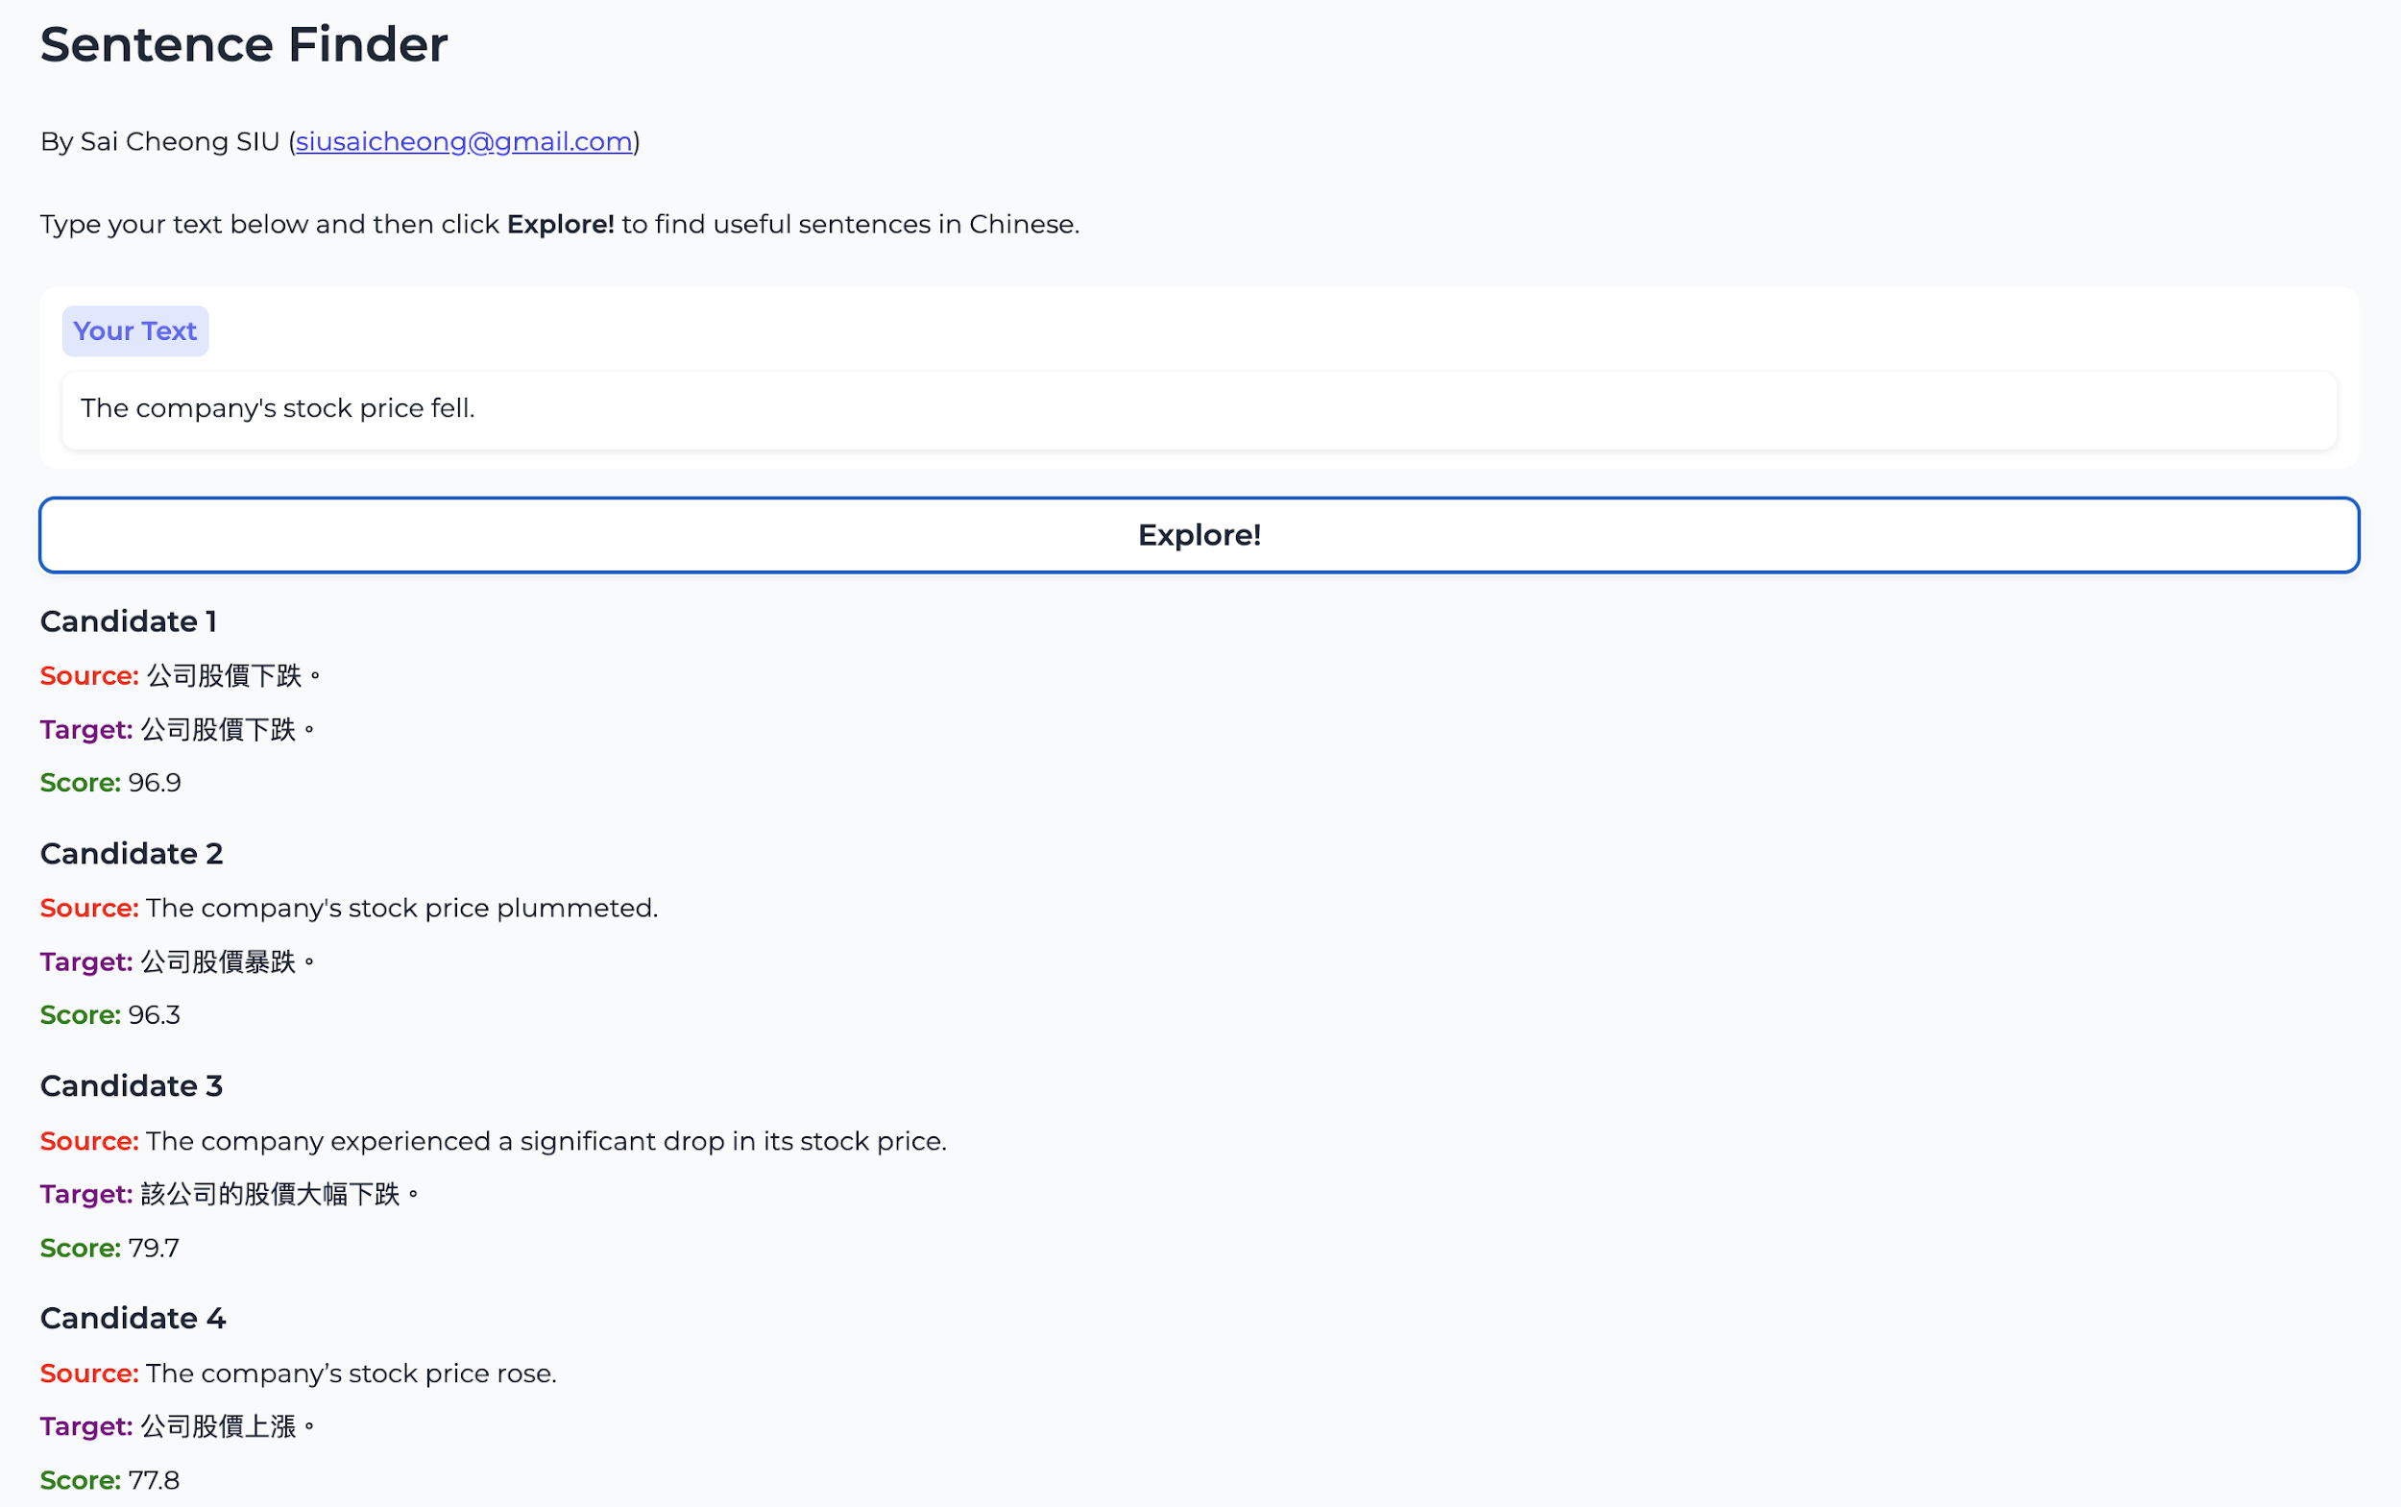

Slide 55
Example
Input: The company's stock price fell.
Conventional method based on string similarity:
Candidate | Score
The company’s stock price rose.* | 83.9%
The company's stock price plummeted. * | 75.7%
The company experienced a significant drop in its stock price.* | 32.3%
*Note: The corresponding Chinese translation is omitted here.

Slide 56
Example
1. More reasonable scores!
Input: The company's stock price fell.
Our Output:
Candidate | Score
The company’s stock price rose.* | 77.8%
The company's stock price plummeted. * | 96.3%
The company experienced a significant drop in its stock price.* | 79.7%
公司股價下跌。 | 96.9%
Lower! TM: 83.9%
Higher! TM: 75.7%
Higher! TM: 32.3%
New! TM: N/A
*Note: The corresponding Chinese translation is omitted here.
2. Cross-lingual retrieval of content

Slide 57
Platform 4: IPOTranslate
“Machine Translation of IPO Documents”
The work described here was fully supported by the Innovation Technology Fund (ITF/238/17).

Slide 58

The need for bilingual IPO prospectuses
An IPO prospectus is a comprehensive document that outlines the details of a company's financial health, operations, and plans.
In Hong Kong, an IPO prospectus must be available in both English and Chinese to cater to the diverse investor base and comply with regulatory requirements.
This has led to a high demand for professional translation services to ensure accurate and timely translations.

Slide 59
Limitations of current MT systems
Machine translation systems may provide a solution, but many of them are designed for the translation of general documents rather than listing documents.
The terms and writing style in automatic translation results often do not conform to those adopted in IPO prospectuses, requiring substantial editing.

Slide 60

Our solution: IPOTranslate
We propose a specialized NMT system designed for the translation of IPO prospectuses, with the following two features:
Feature 1: Domain-specific engines trained on both general and specialized documents.
Feature 2: Dual-engine output based on two models with different network architectures, providing alternative translations for reference.

Slide 61
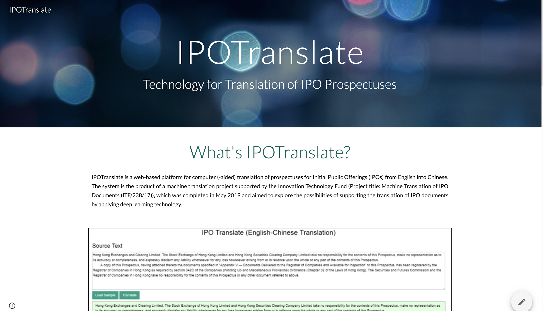

Slide 62
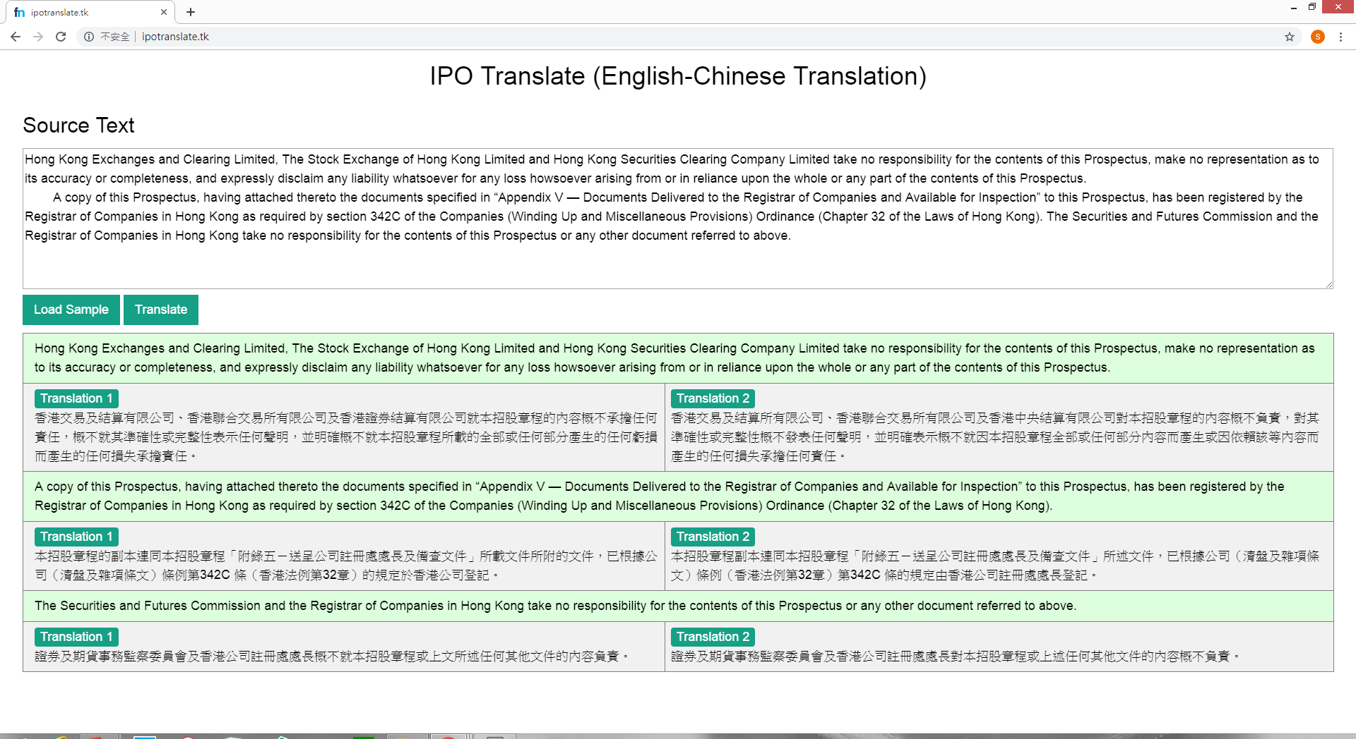

Slide 63
Example 1
Source Text
You should rely only on the information contained in this prospectus and the related Application Forms to make your investment decision.
Human Translation
閣下應僅依賴本招股章程及相關申請表格所載的資料作出投資決定。

Slide 64
Example 1
A famous online MT engine
您應僅依賴本招股說明書中包含的信息和相關的申請表來做出您的投資決定。
Our Translations
閣下僅應依賴本招股章程及相關申請表格所載資料作出投資決定。
閣下應僅依賴本招股章程及相關申請表格所載資料作出投資決定。

Slide 65
Example 2
Source Text
Hong Kong Exchanges and Clearing Limited, The Stock Exchange of Hong Kong Limited and Hong Kong Securities Clearing Company Limited take no responsibility for the contents of this prospectus, make no representation as to its accuracy or completeness and expressly disclaim any liability whatsoever for any loss howsoever arising from or in reliance upon the whole or any part of the contents of this prospectus.

Slide 66
Human Translation
香港交易及結算所有限公司、香港聯合交易所有限公司及香港中央結算有限公司對本招股章程的內容概不負責，對其準確性或完整性亦不發表任何聲明，並明確表示概不會就因本招股章程全部或任何部分內容而產生或因依賴該等內容而引致的任何損失承擔任何責任。
A famous online MT engine
香港交易及結算所有限公司，香港聯合交易所有限公司及香港中央結算有限公司對本招股章程的內容概不負責，亦不對其準確性或完整性作出任何陳述，並明確表示不對任何損失承擔任何責任。 因本招股章程的全部或部分內容而產生或依賴該等招股章程的全部或部分內容。
Our Translations
香港交易及結算有限公司、香港聯合交易所有限公司及香港證券結算有限公司就本招股章程的內容概不承擔任何責任，概不就其準確性或完整性作出任何聲明，並明確不會就本招股章程所載的全部或任何部分內容而產生的任何損失產生任何任何責任。閣下應僅依賴本招股章程及相關申請表格所載資料作出投資決定。
香港交易及結算所有限公司、香港聯合交易所有限公司及香港中央結算有限公司對本招股章程的內容概不負責，對其準確性或完整性概不發表任何聲明，並明確表示概不就因本招股章程全部或任何部分內容而產生或因依賴該等內容而產生的任何損失承擔任何責任。

Slide 67
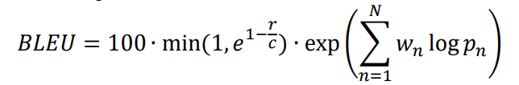
Experiment: results
 | Google | IPOTranslate Model 1 | IPOTranslate Model 2
BLEU Score | 36.89 | 44.48 | 53.73

Slide 68
Case Study 2: Translation of Government Documents

Slide 69
Translation of Government Documents in HK
Government documents in HK are generally issued in both English and Chinese (Traditional Chinese and Simplified Chinese), which are the two official languages of the city under Article 9 of the Basic Law and the Official Languages Ordinance (Cap. 5).

Slide 70
Platform 5: GovPR Translation
An AI-driven platform for the translation of government press releases
The work was supported by a grant from the Research Grants Council of the Hong Kong Special Administrative Region, China (Project No. UGC/FDS14/H16/18).

Slide 71
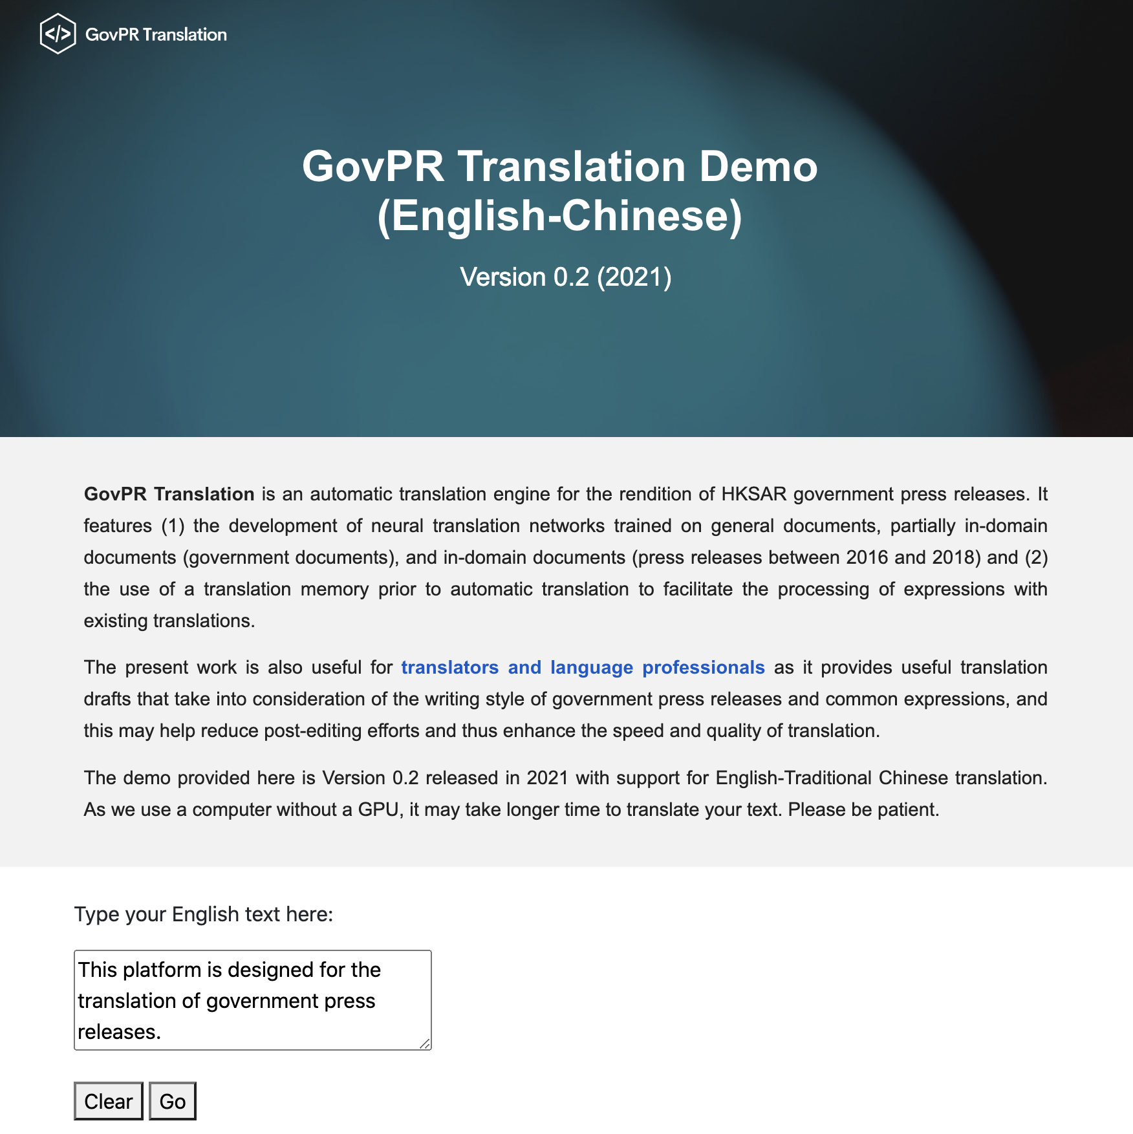
Our system

Slide 72
Hong Kong Government Press Releases
An important communication channel between the government and the public
Information provided by different bureaus and departments
Example: https://www.info.gov.hk/gia/general/today.htm
Three versions: English, Traditional Chinese, and Simplified Chinese

Slide 73
Examples
Announcements
Statements
Speeches
Event promotional materials

Slide 74
Themes
Immigration
Labour
Urban Planning
Finance
Law and Order
Housing and Land
Recreation
Public Health

Slide 75

General Machine Translation?
Word Choices
Sentence Structure
Terminology
Proper Nouns
Formatting
Writing Style

Slide 76
Our Approach
TM + MT

Slide 77



General MT
General data
How?
Domain-specific data

Slide 78
How can we make use of this?
Domain-specific data

Slide 79
A Common Approach
We can use domain-specific data.
However, this often requires re-training or additional training of the model.

Slide 80

Training from scratch
General data
Domain-specific data
Specialized MT
Further Training
General MT
Domain-specific data

Slide 81



(Re-)raining needs

Slide 82

Is it possible to get rid of model (re-)training?
General MT
Domain-specific data

Slide 83


Our Approach
Translation Memory
Machine Translation
Designed for MT (rather than HT)
Containing phrases and sentences
Facilitating the translation of domain-specific content
No re-training or additional training of the model

Slide 84
Our Sample TM
Bilingual government press releases (2016-2018)
408,000 sentence pairs (after automatic alignment)
270,000 translation units (after removal of segments with low interlingual similarity)

Slide 85
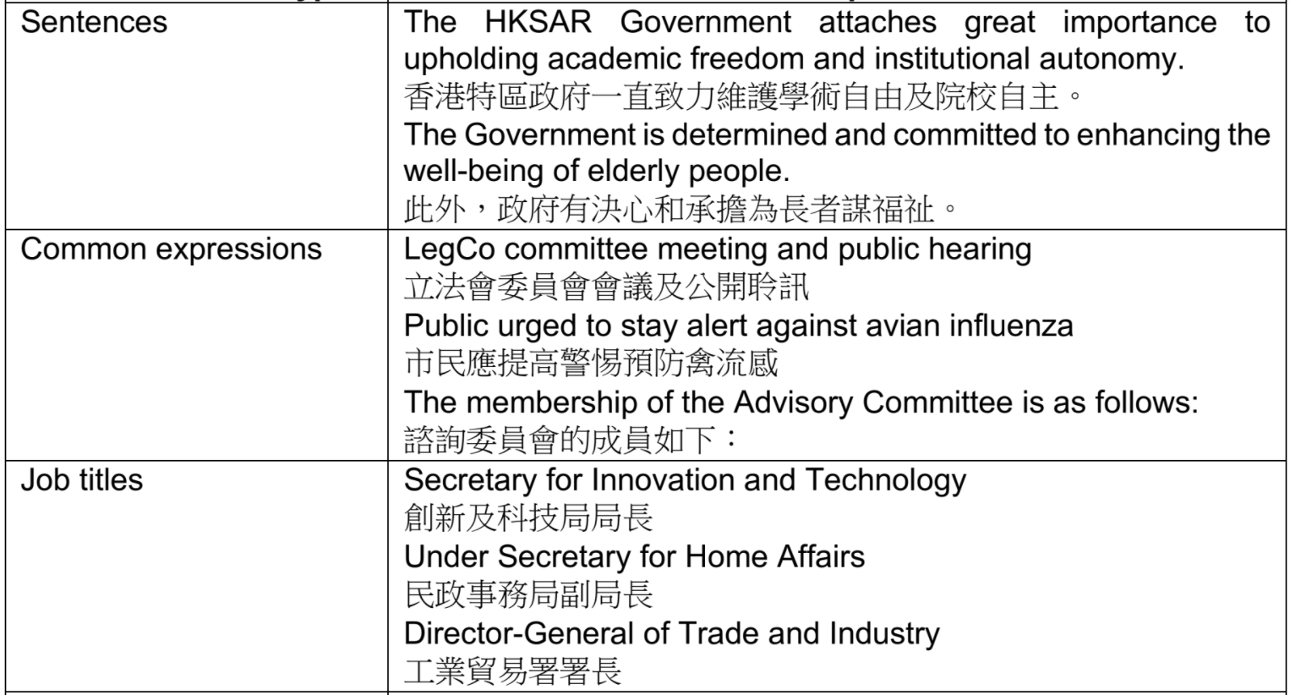
TM Examples

Slide 86
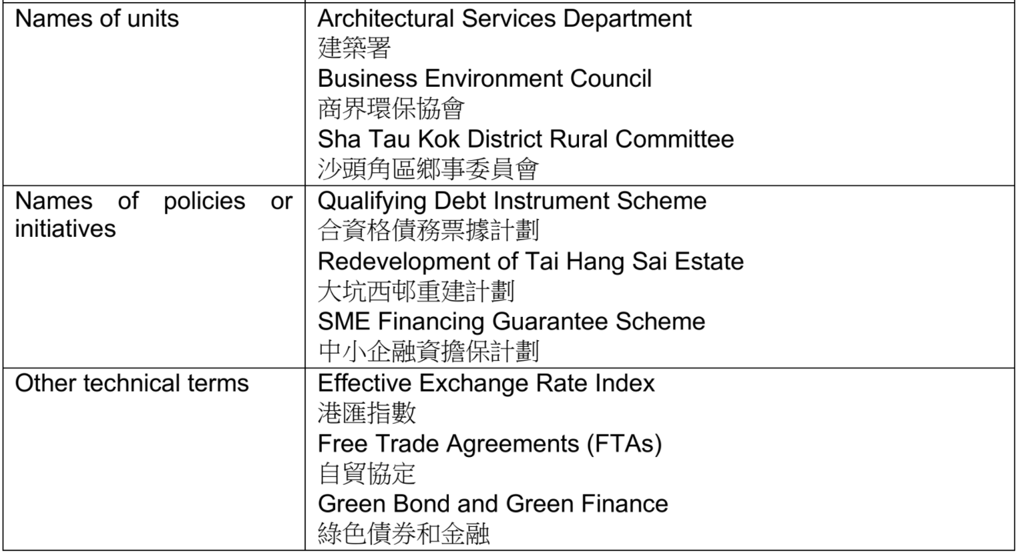
TM Examples

Slide 87
Experiments
Experiment 1: A Popular Online Engine
Experiments 2 and 3: Our Own NMT Models

Slide 88
Experiment 1
Online MT
TM
Online MT
VS

Slide 89
Our Test Dataset
Press releases in January 2019
5,000 bilingual sentences
156,473 English tokens and 130,646 Chinese tokens

Slide 90
Experiment 1: Results
 | Google Translate without pre-translation | Google Translate with pre-translation | BLEU difference after pre-translation
BLEU score based on the test set (BLEU4) | 23.73 | 35.51 | +11.78

Slide 91
Example 1
Source Text: Investigation by the Special Investigation Team of Traffic, Kowloon East is underway.
Reference Translation: 東九龍總區交通部特別調查隊正跟進調查該宗意外。
Output 1 (without pre-translation): 九龍東交通特別調查組正進行調查。
Output 2 (with pre-translation): 東九龍總區交通部特別調查隊正跟進調查案件。

Slide 92
Example 2
Source Text: Admission to the ward has been suspended and restricted visiting has been imposed.
Reference Translation: 該病房已暫停接收新症,並實施有限度探訪安排。
Output 1 (without pre-translation): 該病房已暫停入場，並已實施限制探視。
Output 2 (with pre-translation): 有關病房已暫停接收新症，並實施有限度探訪安排。

Slide 93
Experiment 2
Bidirectional LSTM
Bidirectional LSTM
Bidirectional LSTM
Model 1
Model 2
Model 3
General documents
General documents +
Government documents
General documents +
Government documents +
Government Press Releases
With/out TM

Slide 94
Experiment 2: Results
 | BLEU score of model without pre-translation | BLEU score of model with pre-translation | BLEU difference after pre-translation
Model 1 | 15.56 | 29.28 | +13.72
Model 2 | 18.09 | 31.23 | +13.14
Model 3 | 38.75 | 44.71 | +5.96

Slide 95
Experiment 3
The recent popularity of using the Transformer model (Vaswani et al., 2017) (or its variants) for not only machine translation but also other natural language processing applications (e.g., Devlin et al., 2019) and even image processing (Dosovitskiy et al., 2020) suggests that it would be worthwhile to assess the applicability of our method to NMT engines adopting the self-attention architecture.

Slide 96
Experiment 3
Transformer
Transformer
Transformer
Model 4
Model 5
Model 6
General documents
General documents +
Government documents
General documents +
Government documents +
Government Press Releases
With/out TM

Slide 97
Experiment 3: Results
 | BLEU score for model without pre-translation | BLEU score for model with pre-translation | BLEU difference after pre-translation
Model 4 | 14.40 | 28.28 | +13.88
Model 5 | 18.56 | 30.97 | +12.41
Model 6 | 42.86 | 46.16 | +3.3

Slide 98
Platform 6: Useful Expression Finder
The TM built for GovPR Translation can also be utilized by translators
With semantic similarity calculation, users can find useful bilingual expressions from TM, including not only sentences, as conventional TMs do, but also smaller units like words and phrases.

Slide 99
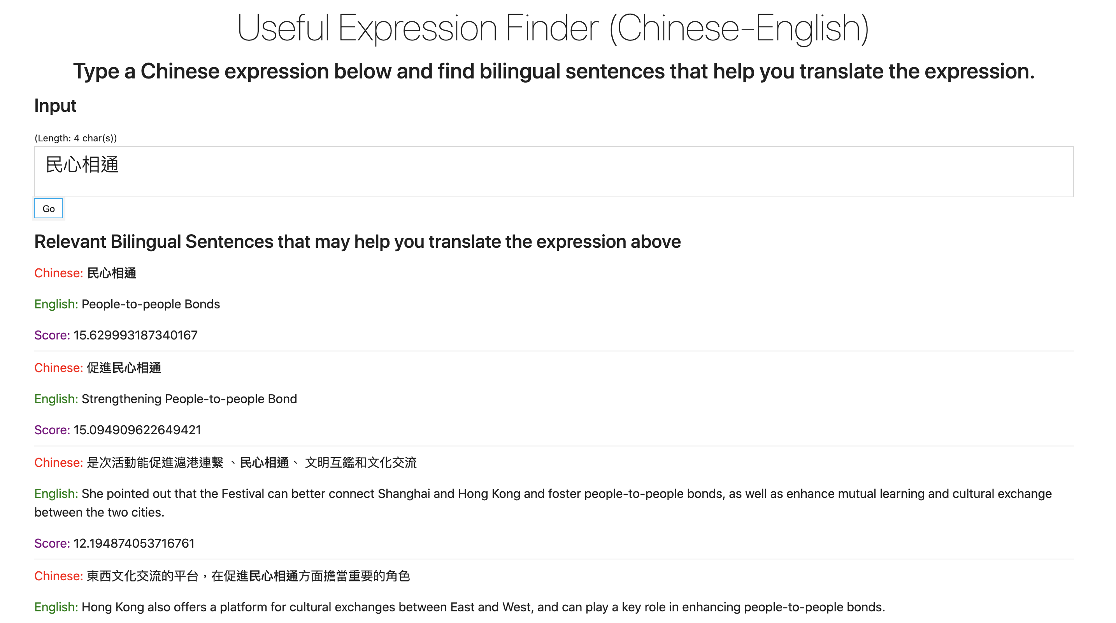

Slide 100
Platform 7: BlendMT
Diversity of Approaches: Different engines use distinct algorithms and training data. Merging captures a broader range of linguistic nuances missed by any single model and mitigate individual weaknesses.
Enhanced Fluency and Readability: Blending diverse sentence structures and phrasing often results in a more natural-sounding, human-like final translation.

Slide 101
Platform 7: BlendMT
Improved Accuracy for Complex Texts: Technical or domain-specific language benefits from cross-referencing multiple interpretations to arrive at the most accurate rendition.
Boosting Efficiency & Cost-Effectiveness: Instead of extensive manual post-editing, combination tools streamline the process, saving time and resources.

Slide 102
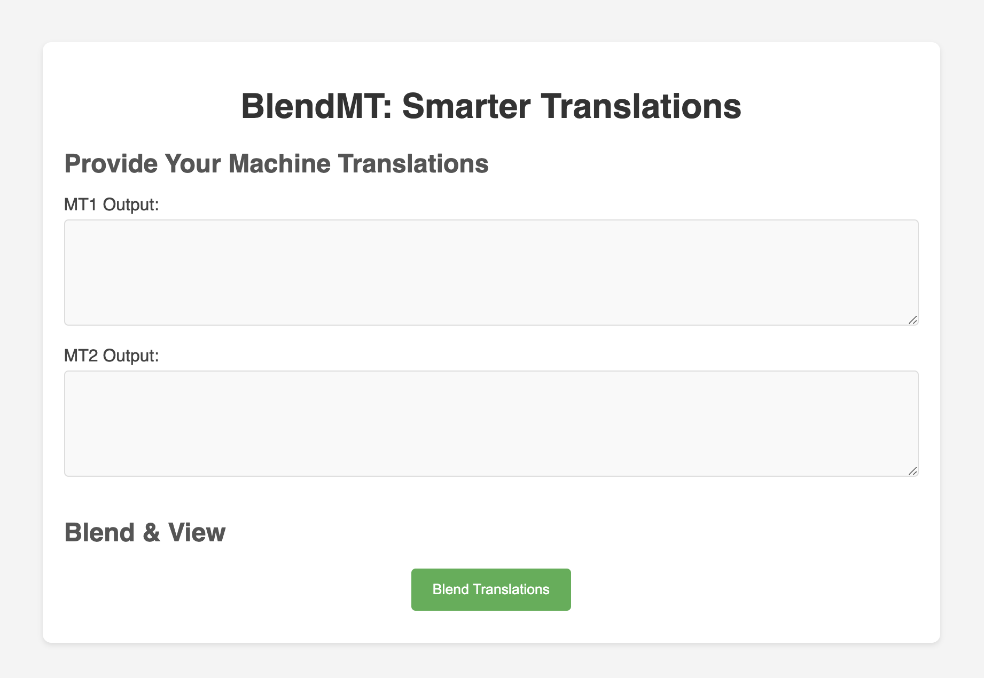

Slide 103
Example: ST
Text input: 我們會持續優化「互聯互通」機制，強化全球最大離岸人民幣業務樞紐地位，助力人民幣國際化。主要措施包括持續提升基礎建設，升級債務工具中央結算系統以便利國際投資者以不同幣種結算各類資產；提升固定收益市場的基建，例如為人民幣計價的回購交易建立中央清算系統，使在港發行的國債於離岸市場成為更受歡迎的抵押品；及繼續研究優化「跨境理財通」。

Slide 104
Example: MT1 and MT2
MT 1: We will continue to optimize the "interconnection" mechanism, strengthen our position as the world's largest offshore RMB business hub, and promote the internationalization of RMB. The main measures include continuing to improve infrastructure and upgrading the central settlement system for debt instruments to facilitate international investors to settle various assets in different currencies; improving the infrastructure of the fixed income market, such as establishing a central clearing system for RMB-denominated repurchase transactions, so that Government bonds issued in Hong Kong have become more popular collateral in the offshore market; and we will continue to study and optimize the "Cross-border Wealth Management Connect".
MT 2: We will continue to enhance the “interconnection and connectivity” mechanism to strengthen our position as the world's largest offshore RMB business hub and facilitate the internationalization of RMB. Key measures include continuous enhancement of infrastructure, upgrading the Central Moneymarkets Unit to facilitate international investors to settle various assets in different currencies; upgrading the infrastructure of the fixed income market, for example, setting up a central clearing system for RMB-denominated repurchase transactions, so as to make treasury bonds issued in Hong Kong a more popular form of collateral in the offshore market; and continuing to study the enhancement of the “Cross-border Wealth Management System”.

Slide 105
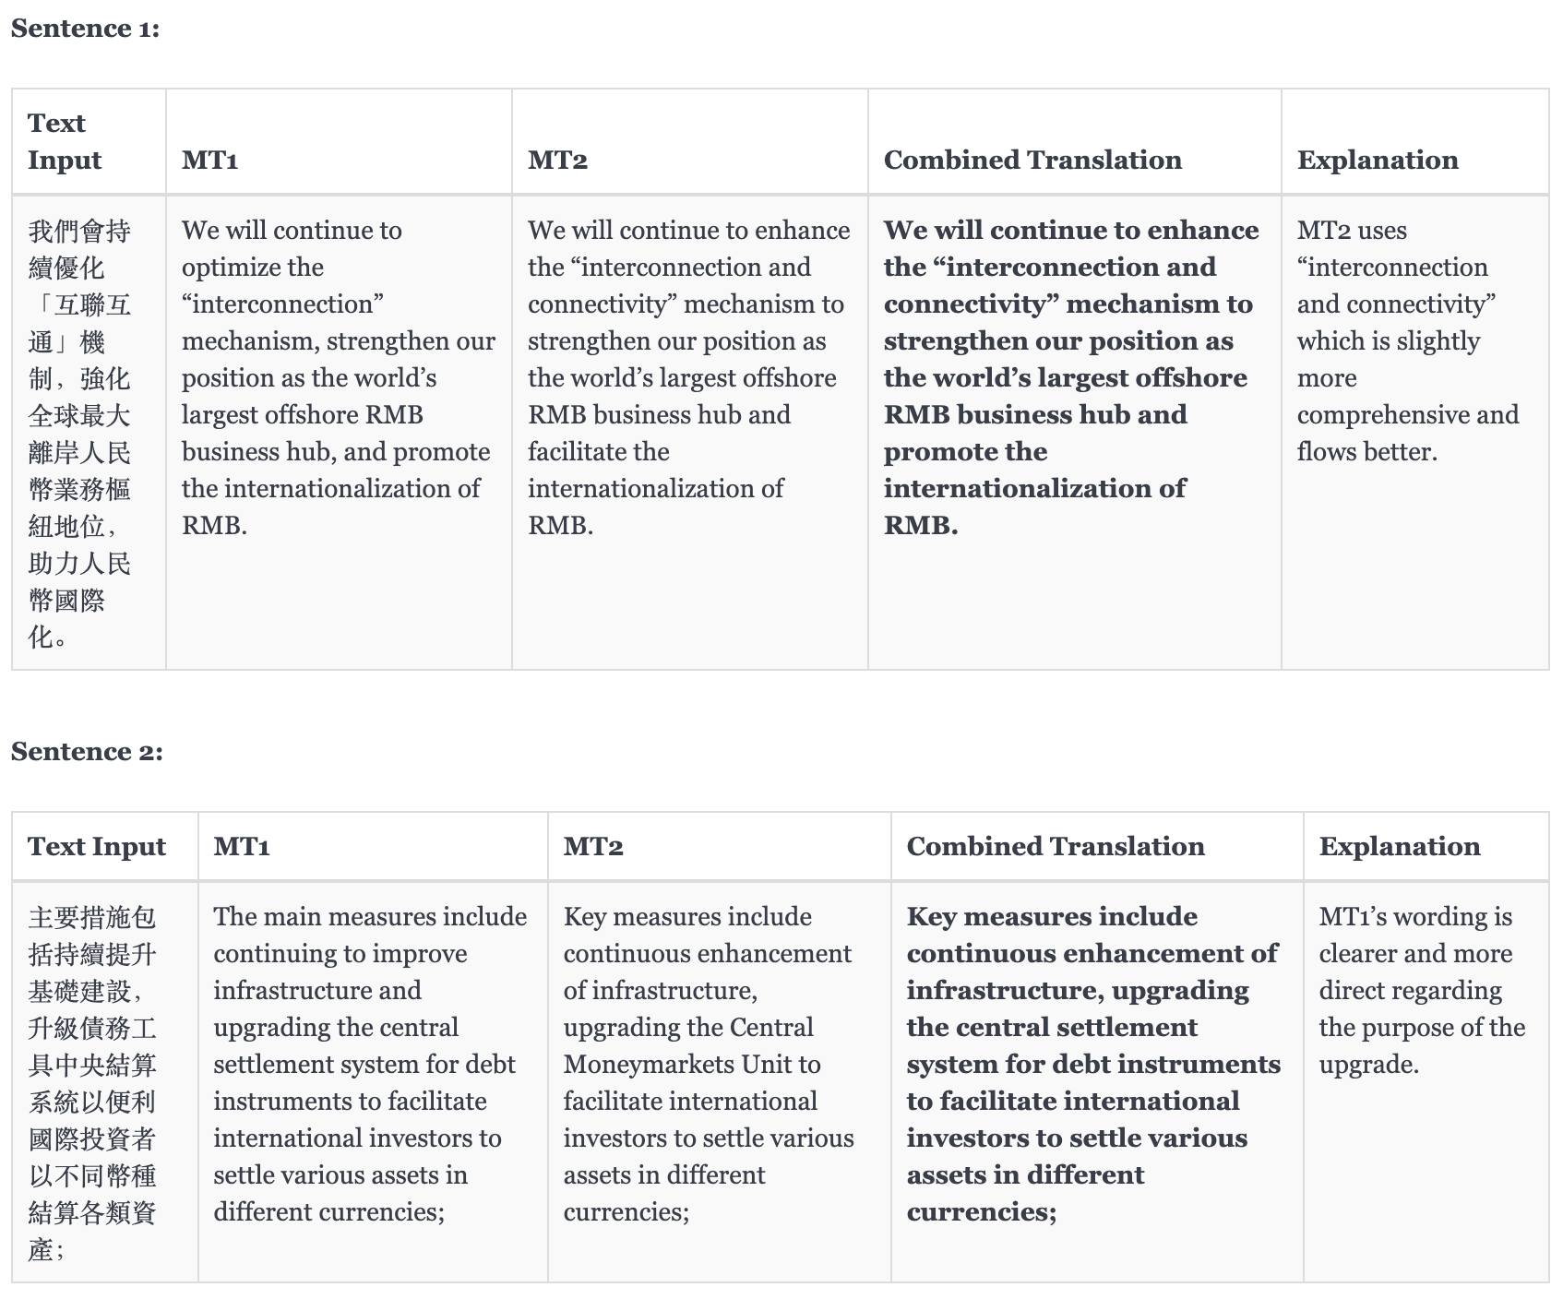

Slide 106
Platform 8: MTCheck
This is a tool designed to enhance the quality assurance of machine translation output.
Existing CAT tool QA checkers tend to focus on surface-level errors (grammar, spelling, punctuation).
This tool offers actionable revisions & insights. It doesn't just flag errors, but provides corrected translations and concise explanations for suggested changes. This empowers translators to learn and improve.

Slide 107
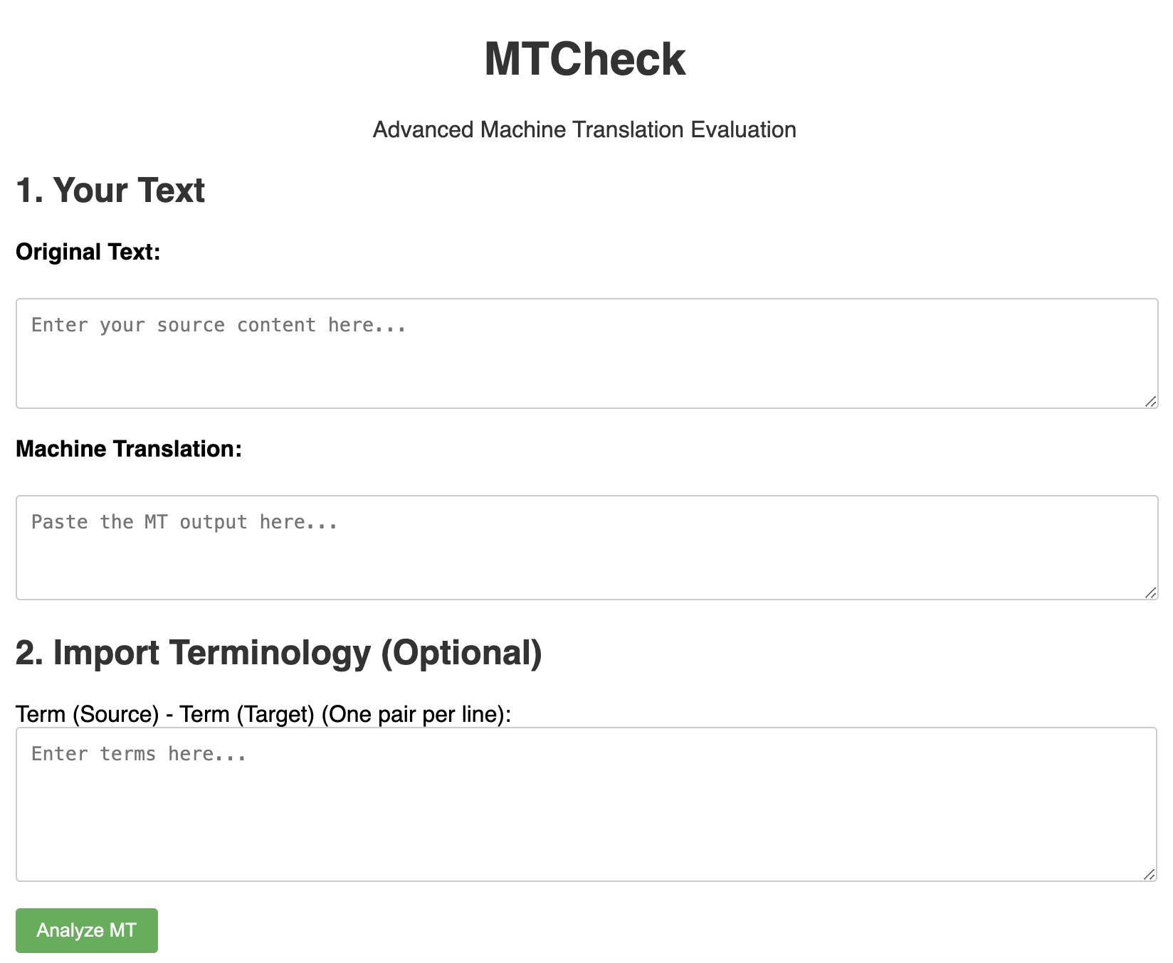

Slide 108
Example (ST)
完善新型工業發展策略和體制建設
76. 我們將制訂香港新型工業中長期發展方案，並推動成立「香港新型工業發展聯盟」，促進「政、產、學、研、投」緊密協作，構建香港新型工業合作平台，包括提供融資機會、促進新來港上市企業與本地大學開展創科合作等。
推進第三個「InnoHK創新香港研發平台」
77. InnoHK現匯聚本地和全球各地約2 500名科研人員。政府已開展籌備建設第三個InnoHK研發平台，聚焦先進製造、材料、能源及可持續發展，吸引世界級的科研團隊與本地院校合作，推動科研，匯聚人才。

Slide 109
Example (Sample MT)
Improving the strategy and institutional framework for the development of new industries
76. We will formulate a medium-to-long-term development plan for Hong Kong's new industries and promote the establishment of the Hong Kong Alliance for the Development of New Industries to foster close collaboration among the Government, industry, academia, research and investment, and to build a platform for cooperation among Hong Kong's new industries, including the provision of financing opportunities, and the facilitation of collaboration in innovation and technology between newly-listed enterprises and local universities, etc. We will also promote the establishment of a third InnoHK R&D platform to provide a platform for the development of new industries.
Taking forward the third InnoHK R&D platform
77. InnoHK is currently home to some 250 researchers from local and worldwide. The Government has commenced preparations for the construction of the third InnoHK R&D platform, which focuses on advanced manufacturing, materials, energy and sustainable development, and attracts world-class research teams to collaborate with local institutions to promote R&D and pool talents.

Slide 110
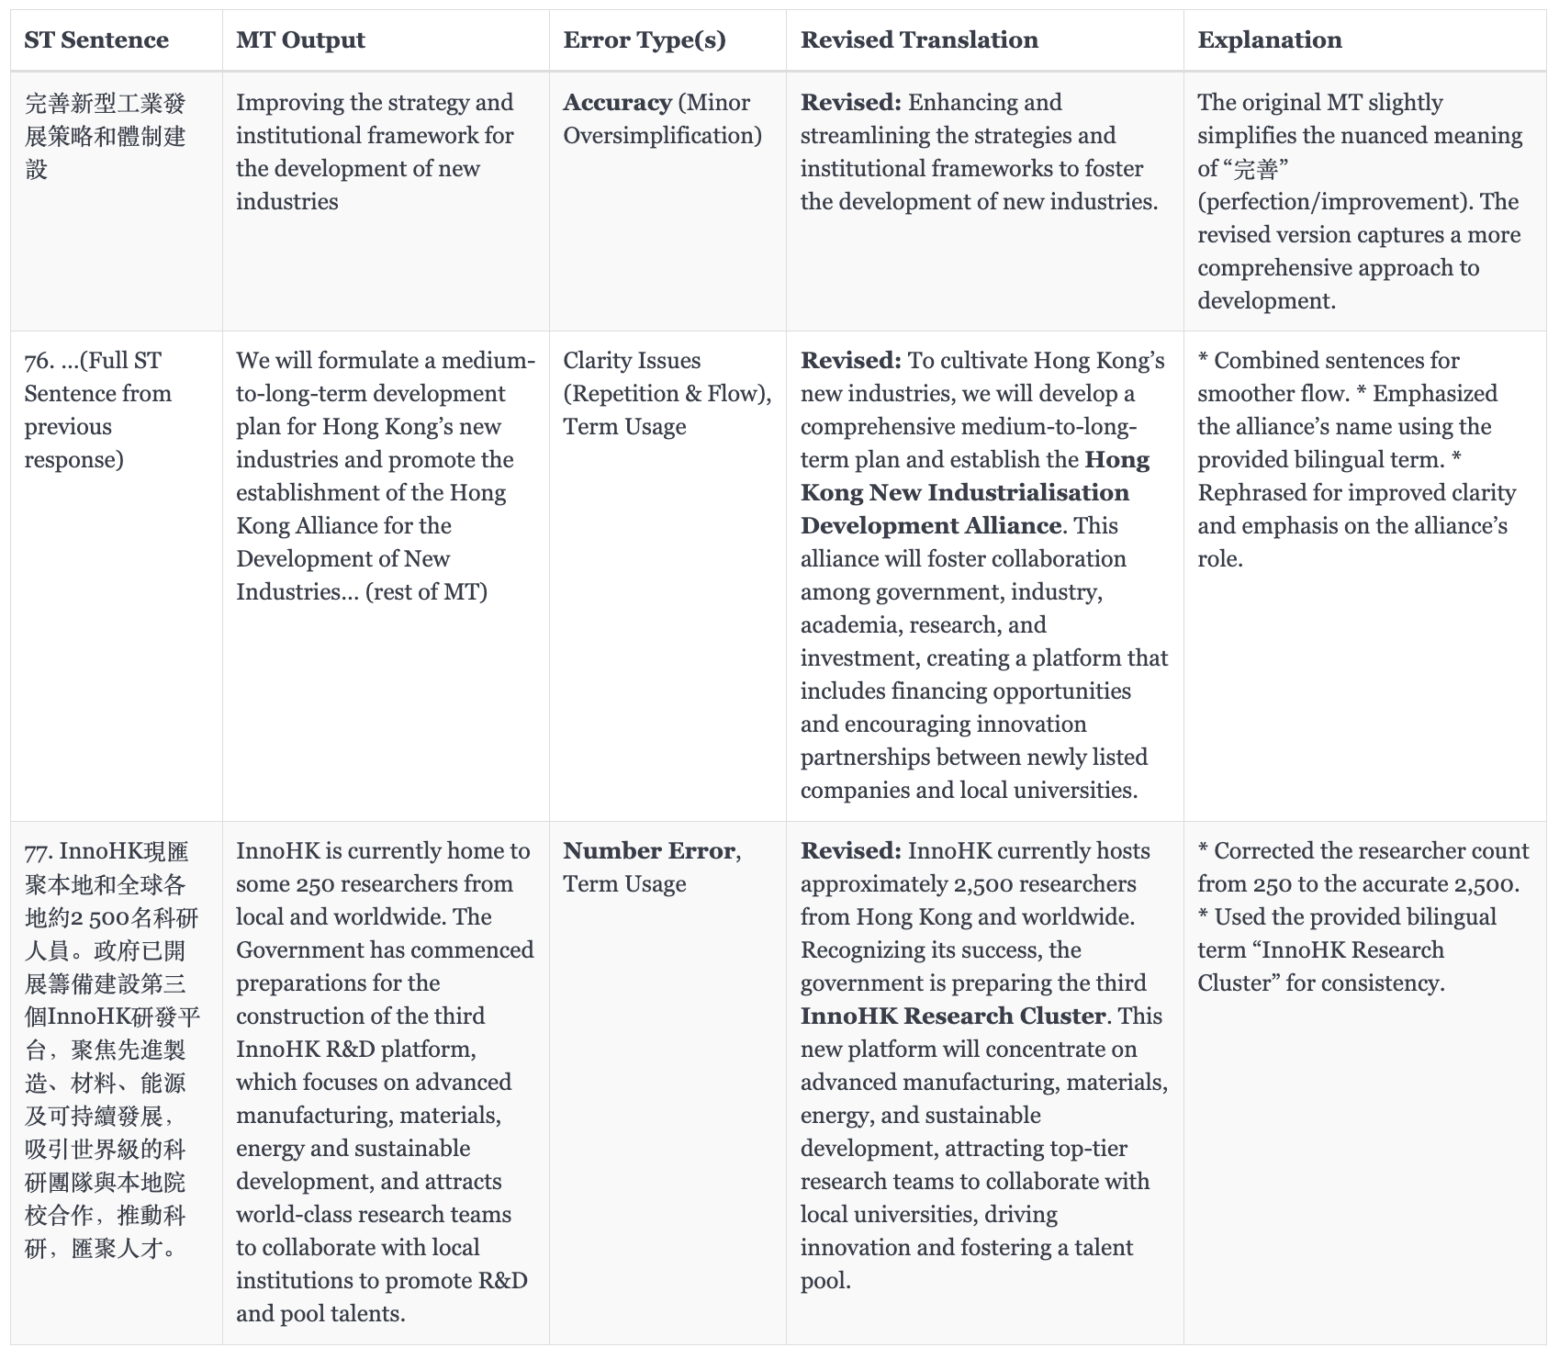

Slide 111

The Way Forward

Slide 112















The Way Forward (see Siu 2023b)
Multilingual NMT
Multiple Models
Deeper Models
Multiple language pairs
More Layers
Document-level NMT
Domain Adaptation
Pre-trained language models (e.g., ChatGPT)
As sentences
Connection
1
2
3
1. Pre-training
3. Multiple Tasks!
2. Fine-tuning / Prompt engineering
As a document
Specialized translation models

Slide 113
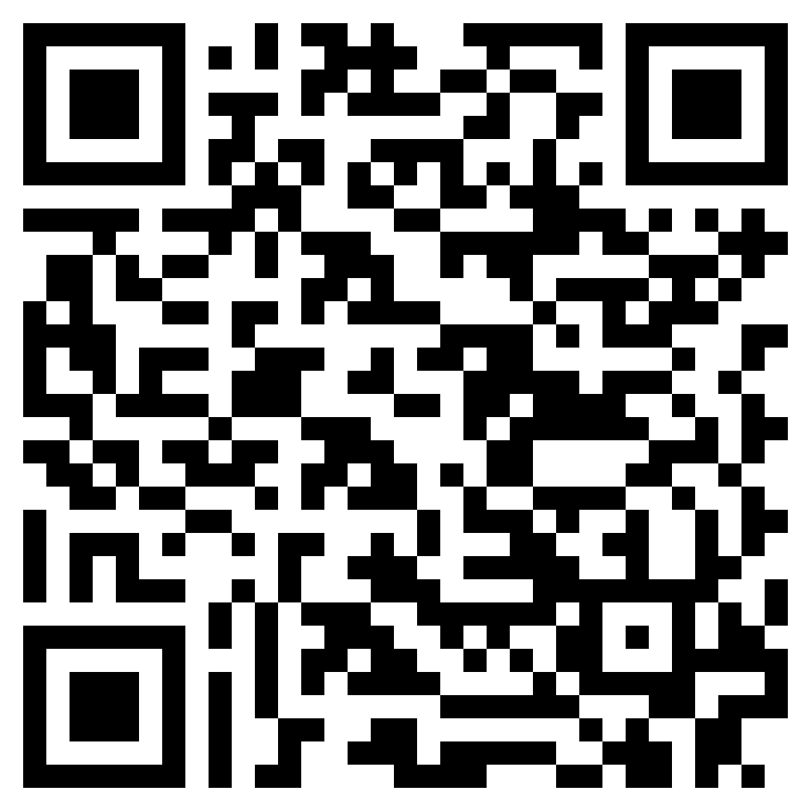
Read More
“ChatGPT and GPT-4 for Professional Translators: Exploring the Potential of Large Language Models in Translation” (Siu 2023a) [Link]
An Overview of ChatGPT and its Predecessors
ChatGPT as a Tool for Translators: Exploring Use Cases
Strengths and Limitations of ChatGPT in the Context of Translation
Impacts of ChatGPT on Translators and Language Professionals
The Future of ChatGPT as a Translation Tool

Slide 114
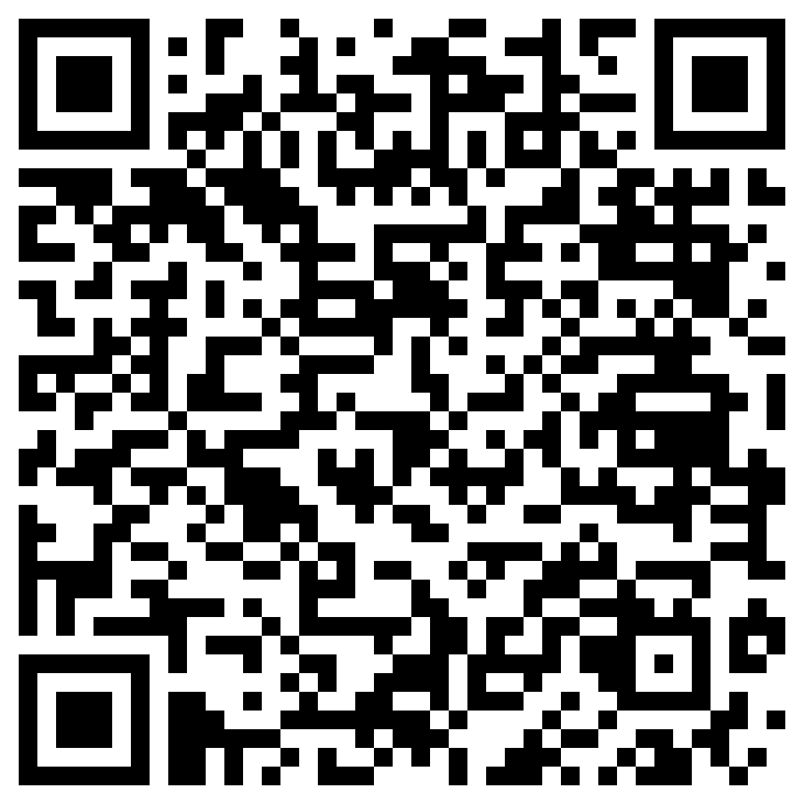
Read More
“Deep Learning and Translation Technology” - see Chapter 47, Routledge Encyclopedia of Translation Technology (2nd Edition) (Siu 2023b)
An Introduction to Deep Learning
Main Tasks of Deep Learning
An Overview of Neural Machine Translation
Recurrent Neural Networks for Translation
Convolutional Neural Networks for Translation
Self-attention Neural Networks for Translation
Deep Learning for Other Translation-related Applications
Other Noteworthy Trends

Slide 115

Read More
“Revolutionising Translation with AI: Unravelling Neural Machine Translation and Generative Pre-trained Large Language Models” (Siu 2023c) [Link]
An Overview of Deep Learning
The Transformer Model Explained
AI for Translation: NMT and Generative Pre-trained
Strengths and Limitations of NMT and LLMs
Recommendations for Translation Educators
Recommendations for Developers

Slide 116
Thank you!
scsiu@hsu.edu.hk
siusaicheong@gmail.com

